Slide 1

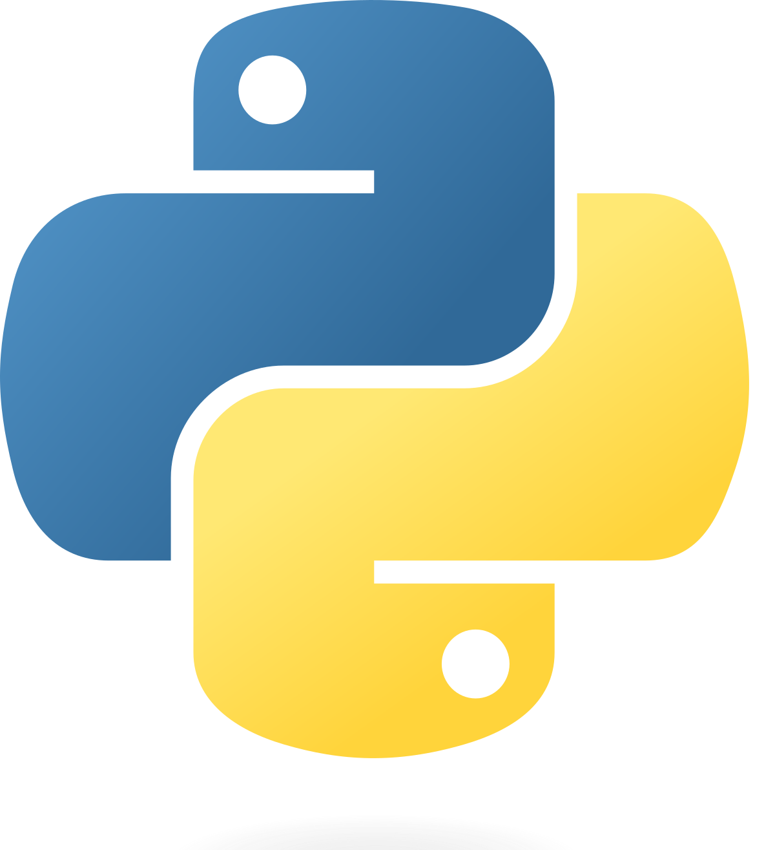
Introduction to Python

Slide 2

Kurnia Anwar Ra’if
A Highly-motivated Data Scientist
Senior Data & AI Platform - PT. Mastersystem Infotama Tbk
Data Scientist @ PT. KitaLulus International
Data Scientist @ PT. Sharing Vision– BRI Consultant
Software Engineering @ PT. AILIMA Geothermal
Mentor DS/BI/AI-ML - @ Dibimbing.id

Slide 3

Outline :
What is Python and Why is it Suitable for Beginners?
Why Should Data Scientists Learn to Code?
Basic Python Syntax

Slide 4
What is Python and Why is it Suitable for Beginners ?

Slide 5
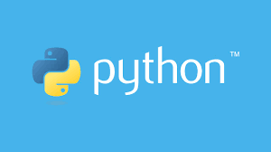
What is Programming?
Programming is the process of giving logical instructions to a computer so that it can perform specific tasks automatically.
Intro to Python
Basic Concept :
📥 Input → ⚙️ Process → 📤 Output
Notes:
Python adalah sebuah high-level programing language yg object oriented
Object oriented disini maksudnya berarti dalam menuliskan code python akan berdasarkan konsep objek
Objek disini dapat berupa function / class.
Saya ingin sekali membahas terkait konsep class & function di Python,
namun sayangnya berada diluar scope kelas hari ini.
Namun, saya sempat membagikan link pengenalan untuk class & function di Python,
semoga dengan membaca artikel tersebut dapat lebih paham mengenai class & function di Python.
Selain object oriented, python juga merupakan high-level programming language
High-level disini artinya Python merupakan programming language yg lebih human readable dibanding machine-readable
Berikut perbandingan terhadap beberapa programming language lainnya.
Jadi, semakin machine-readable, maka process untuk menjalankan suatu code akan lebih cepat.
Python sendiri juga tidak hanya dapat digunakan untuk programming di Data Science saja,
tapi bisa juga untuk berbagai use-case lainnya seperti membuat website, membuat game, dsb.
Tapi alasan utama mengapa Python banyak diadopsi untuk keperluan Data Science, karena
banyaknya packages/library yg dibuat dengan menggunakan bahasa Python.

Slide 6
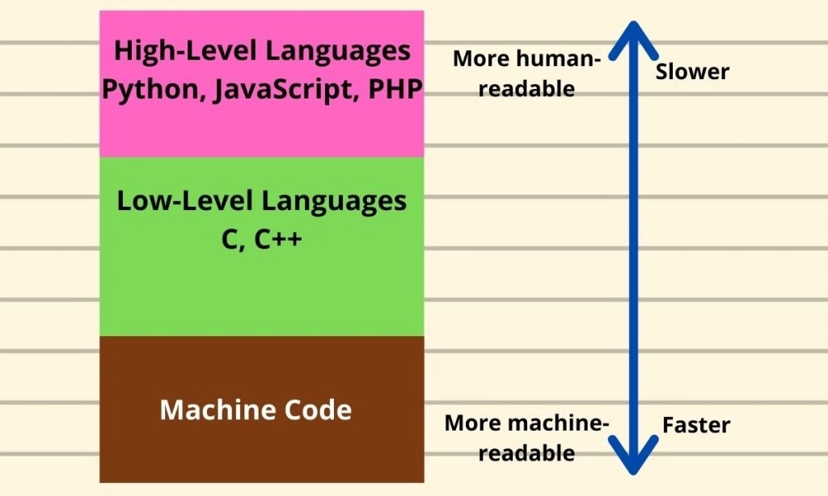
Python -> Object Oriented Programming & High Level Programming
1. What is Python ?
Tidak hanya untuk Data Science saja, melainkan untuk pembuatan game, website, dan python memiliki beragam package / libraries.

Slide 7




An IDE (Integrated Development Environment) is an application that provides all the tools a programmer needs to write, test, and run code in one place.
Python Tools IDE (Integrated Development Environment)
Jupyter Notebook
VS Code
Anaconda Navigator
Google Colab
Notes:
Untuk di kelas ini kita akan memakai Google Colab sbg Python IDE kita.

Slide 8
Why Should Data Scientists Learn to Code?

Slide 9

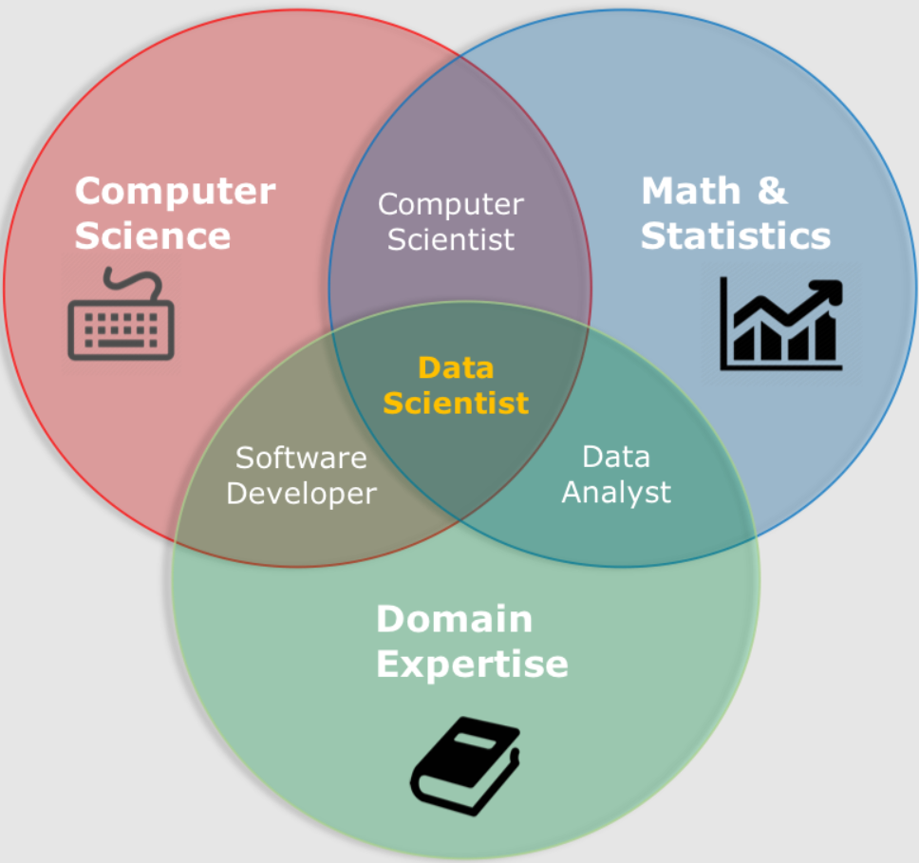
Who is Data Scientist ?
Source : Google

Slide 10
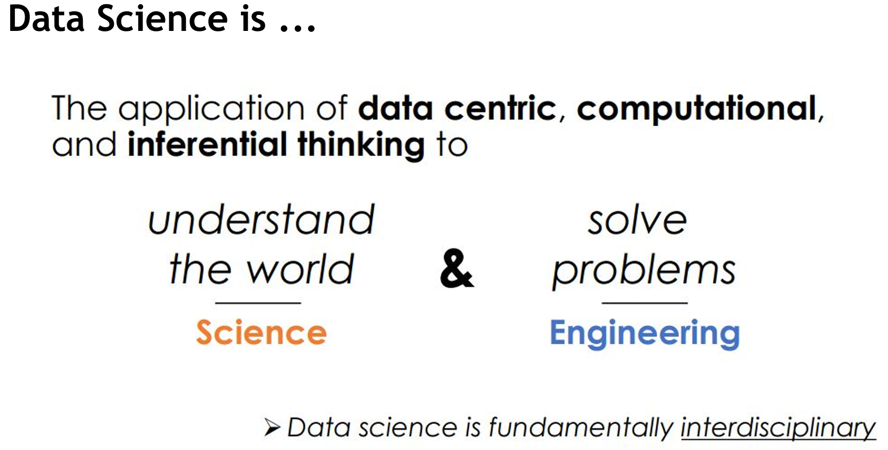
Who is Data Scientist ?

Slide 11
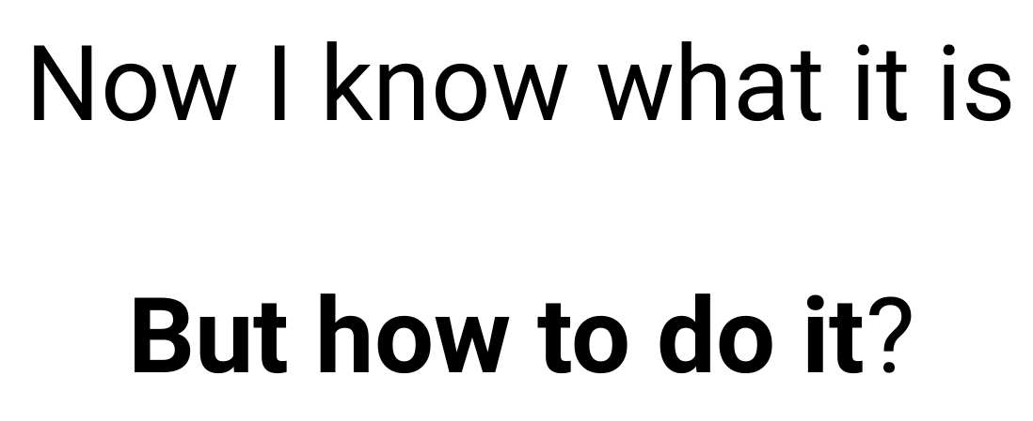
Who is Data Scientist ?

Slide 12
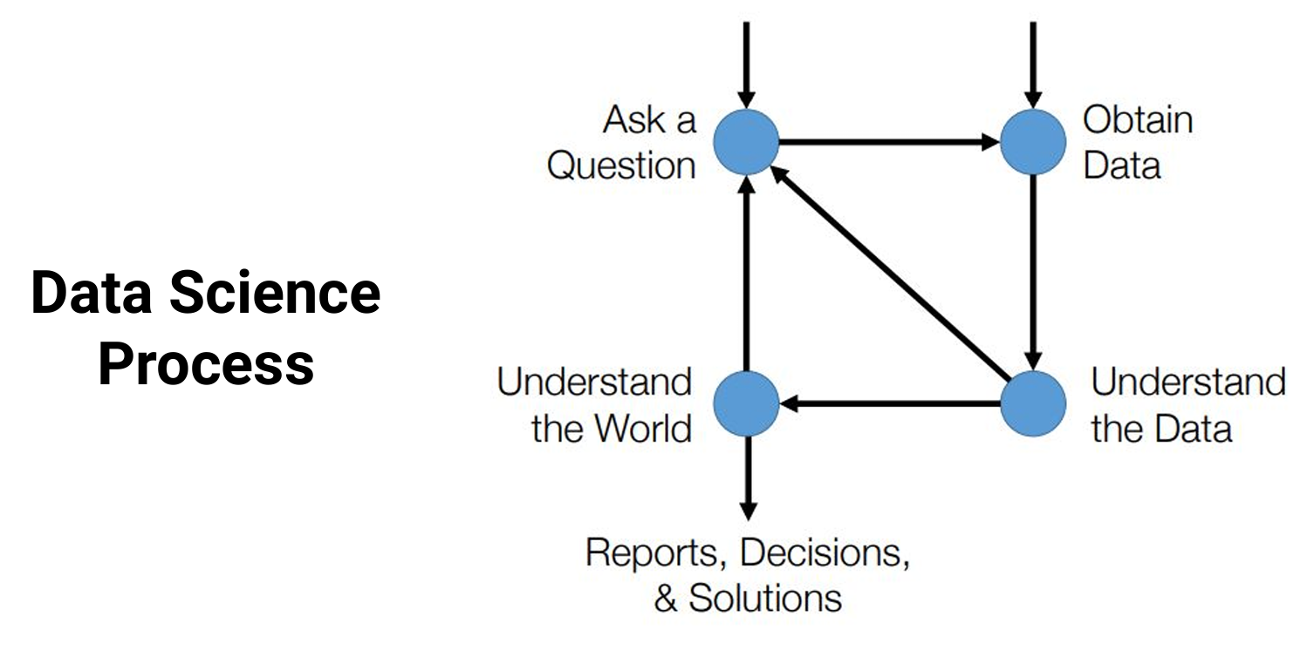
Who is Data Scientist ?

Slide 13
Conclusion why must learn coding ?
Data Acquisition and Cleaning -> Using libraries scikit-learn, pandas, numpy and so on
Need
Exploratory Data Analysis and Visualization -> Using libraries Matplotlib, Seaborn, Plotly
Need
Predictions and Inference related to Machine / Deep Learning -> Using libraries Scikit-learn, PyTorch, TensorFlow
Need

Slide 14
Basic Python Syntax

Slide 15
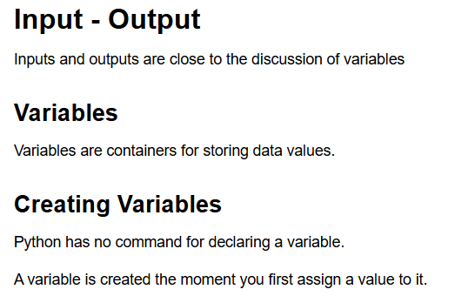
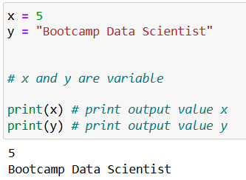
Basic Syntax Python

Slide 16
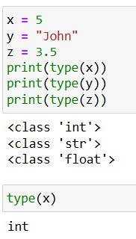

Basic Syntax Python

Slide 17

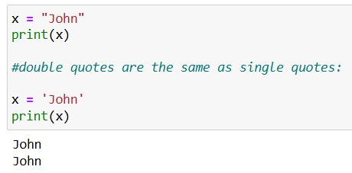
Basic Syntax Python

Slide 18
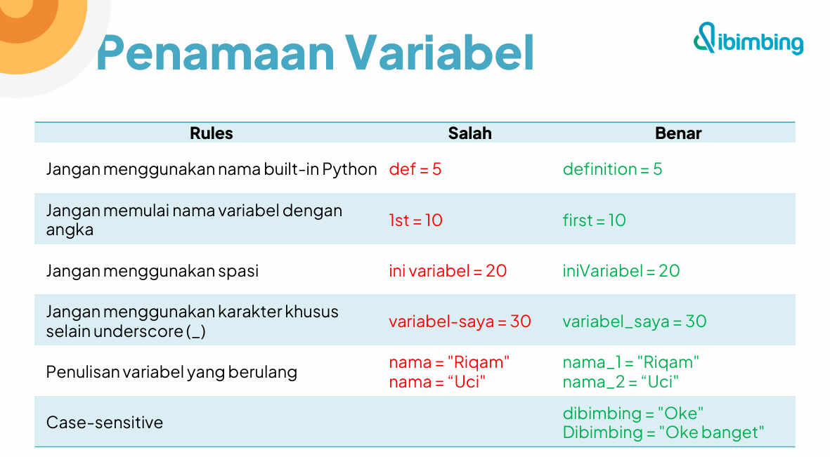

Slide 19
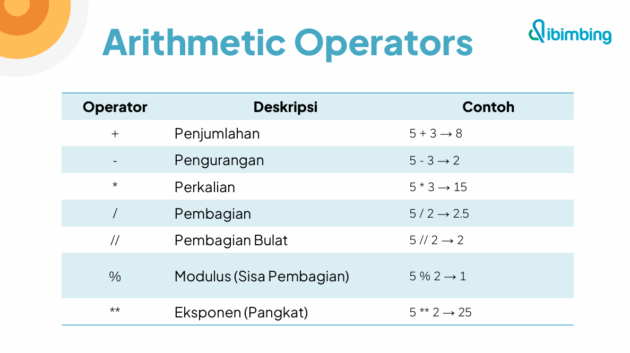

Slide 20
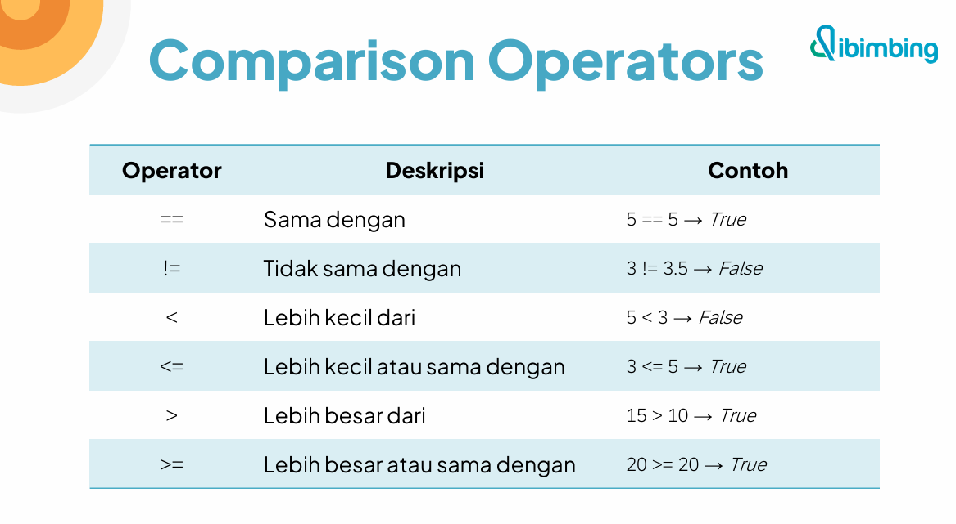

Slide 21
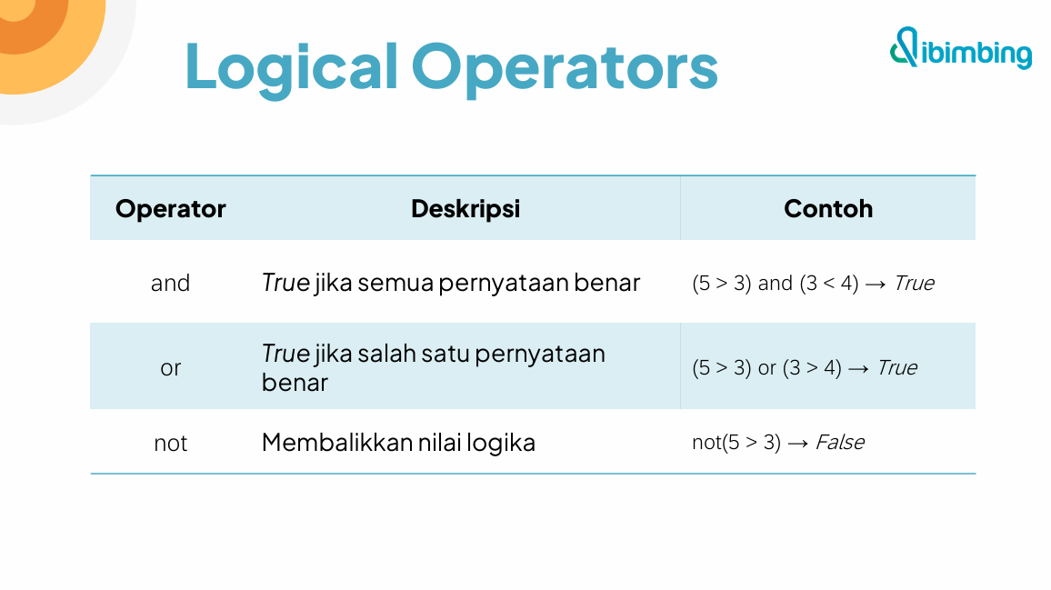

Slide 22
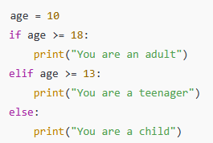
Basic Syntax Python
The if statement checks whether a condition is True. If it is, the indented block of code under it will be executed.
elif (else if) Used to check another condition if the previous if condition was False. You can have multiple elif blocks.
The else block is executed when none of the previous conditions are True.
Summary :
- if: checks the first condition
- elif: checks additional conditions
- else: runs if none of the above conditions are true
These are essential for building decision-making logic in your Python programs.

Slide 23
Brief Assignment

Slide 24
Brief Assignment :
Jawablah pertanyaan dari code template di link ini : https://drive.google.com/file/d/1EILe4RvamXXJeBjYVg1H5TPhH7r_-Sqb/view?usp=sharing

Slide 25
Q & A

Slide 26


Thank you
https://www.linkedin.com/in/anwaraif/
kurniafreelancer@gmail.com

